Slide 1
4 Transform-and-Conquer

Slide 2
Transform-and-Conquer
Design methods based on the idea of transformation.
Two-stage procedures:
In the transformation stage,
modify the problem’s instance to be more amenable to solution, for some reasons.
In the conquering stage,
it is solved.

Slide 3

Transform-and-Conquer
Transform-and-conquer strategy:
simpler instance
or
Problems’ another representation solution
instance or
another problem’s instance
(problem reduction)
transformation stage conquering stage

Slide 4
Transform-and-Conquer
Three major variations by what we transform a given problem’s instance to:
instance simplification - transformation to a simpler instance of the same problem.
representation change – transformation to a different representation of the same instance.
Problem reduction – transformation to an instance of a different problem for which an algorithm is already available.

Slide 5
Transform-and-Conquer
Representation Changes
Examples of the representation change.
Gaussian elimination solves a system of linear equations:
transform it to another system that makes finding a solution easier.
Balanced Search Trees, including AVL trees:
transform an unbalanced binary tree to a binary search tree (also considered to be an instance simplification)
Heaps and heapsort, Horner’s rule and Binary Exponentiation

Slide 6
Transform-and-Conquer - Representation Changes
Heaps and Heapsort

Slide 7
Recall:
Representation Changes:
Gaussian elimination solves a system of linear equations by first transforming it to another system that makes finding a solution quite easy.
Balanced Search Trees, including AVL trees (transformation from an unbalanced binary tree to a binary search tree is considered to be instance simplification) is an example of the representation change technique.
Heaps and heapsort, Horner’s rule and Binary Exponentiation are considered examples of the representation change.

Slide 8
When a ≤ b, we say that a is related to b.
This does not imply that b is also related to a, because the relation need not be symmetric.).
A partial order is a binary relation ≤ over a set P satisfying particular axioms:
the relation ≤ is reflexive, antisymmetric and transitive.
For all a, b, and c in P, the relation ≤ must satisfy:
a ≤ a (reflexivity: every element is related to itself).
If a ≤ b and b ≤ a, then a = b (antisymmetry: two distinct elements cannot be related in both directions).
If a ≤ b and b ≤ c, then a ≤ c (transitivity: if a first element is related to a second element, which is, in turn, related to a third element, then the first element is related to the third element).
In other words, a partial order is an antisymmetric preorder.
1
3
(1, 2, 3)

Slide 9
Heaps and Heapsort
Priority queues:
implemented based on partially ordered data structure.
A priority queue is
a multiset of items with an orderable characteristic (an item’s priority), with the following operations:
Finding an item with the highest (i.e., largest or lowest) priority
Deleting an item with the highest priority
Adding a new item to the multiset.
Applications: Operation systems’ Scheduling job executions, traffic management by communication networks; Prim’s algorithm, Dijkstra’s algorithm, Huffman encoding, branch-and-bound applications.

Slide 10
Notion of the Heap
Definition:
A heap (a data structure) can be defined as
a binary tree with keys assigned to its nodes (one key per node) satisfied the following two conditions:
1. The tree’s shape requirement:
the binary tree is essentially complete:
all its levels are full except possibly the last level, where only some rightmost leaves may be missing.
2. The parental dominance requirement: It is
a max-heap if it requires the key at each node to be greater than or equal to the keys at its children, or
a min-heap if it requires the key at each node to be less than or equal to the keys at its children.

Slide 11
Consider the trees of Figure 6.9.
The tree’s shape requirement:
The parental dominance requirement:
10
1 2 3 4 5 6
5
7
10 | 5 | 7 | 4 | 2 | 1
2i and 2i+1
4
2
1
An example of a heap.
A complete binary tree and max heap.
The tree has height two;
The tree is stored in an array.
e.g., The node at index 3 has a value 7.

Slide 12
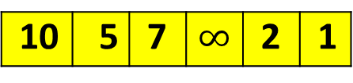
Consider the trees of Figure 6.9.
10
5
7
10 | 5 | 7 | $$∞$$ | 2 | 1
2
1
This is not a heap, because the tree’s shape requirement is violated.
All its levels are full except possibly the last level, where only some rightmost leaves may be missing.

Slide 13
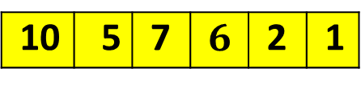
Consider the trees of Figure 6.9.
10
5
7
10 | 5 | 7 | $$6$$ | 2 | 1
6
2
1
It is not a heap, because the parental dominance requirement is violated.
The binary tree fails to be a max heap for the node with key 5 is less than one of its child node with key 6.

Slide 14
Heap
In a max or min heap,
Key values in a heap are ordered top down:
key values on any path from the root to a leaf is decreasing or increasing (respectively, nonincreasing or nondecreasing, if equal keys are allowed.)
no left-to-right order in key values;
no relationship among key values for nodes in the left and right subtrees of the same node.
i.e., no relationship among key values for nodes either on the same level of the tree or,

Slide 15
Important properties of heaps:
There exists exactly one essentially complete binary tree with n nodes, with height └ log₂ n ┘.
As a max heap, the root of a heap always has its largest element.
Every subtree of a heap is also a heap.
Every node of a heap with all its descendants is also a heap.
Its root of the descendants contains its largest element again.
...

Slide 16
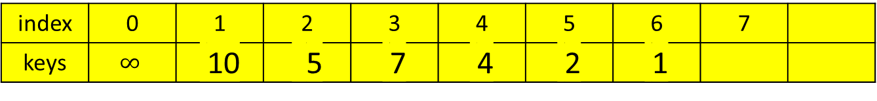
Important properties of heaps:
A heap can be implemented as an array H[0..n] by
recording its elements in the top down, left-to-right fashion.
Store the heap’s elements in position 1 through n of the array H[0..n],
H[0] is either unused or having a sentinel whose value is greater than every element in the heap.
In array representation,
position 1
2 3
4 5 6 7
index | 0 | 1 | 2 | 3 | 4 | 5 | 6 | 7
keys | $$∞$$ | 10 | 5 | 7 | 4 | 2 | 1
2i and 2i+1

Slide 17
Important properties of heaps:
In array representation H[0 .. n] of a heap,
The parental node keys will be in the first └ n/2 ┘ positions of the array, while the leaf keys will occupy the last ┌ n/2 ┐ positions;
e.g., if n = 7 then
└ 7/2 ┘= 3 positions will be parental node keys {1, 2, 3}
and ┌ 7/2 ┐ = 4 positions will be the leaf keys. {4, 5, 6, 7}
If a parental key is in the array’s parental position i (1 ≤ i ≤ └n/2┘),
the children of this parental key will be in positions 2i and 2i+1.
Conversely, if the child key is in position i (2 ≤ i ≤ n),
the parent of this key will be in position └ i /2 ┘.
position 1
2 3
4 5 6 7

Slide 18
Figure 6.10. Heap and its array representation
10
The array representation
index
1 2 3 4 5 6
5
7
 | 10 | 5 | 7 | 4 | 2 | 1
value parents leaves
4
2
1
An example of a heap.
A complete binary tree and max heap.
The tree has height two;
The tree is stored in an array.
e.g., The node at index 3 has a value 7.

Slide 19
The first └n/2┘ = 3 positions are parents nodes keys
The leaf keys occupy the last ┌ n/2 ┐ = 3 positions.
If n = 7, then the leaf keys will occupy the last ┌n/2┐ = 4 positions
The children of the key = 5 in the array’s position i = 2, ( 1 ≤ i ≤ └n/2┘) are in the positions 2i and 2i +1, that is 2*2 = 4 and 2*2 + 1 = 5, which contain keys 4 and 2, respectively.
10
5
7
4
2
1

Slide 20
Define a heap as an array H[1..n] in which every element (key) in position i in the first half of the array is greater than or equal to the elements (keys) in position 2i and 2i + 1, i.e.,
H[i] ≥ max{H[2i], H[2i+1]} for i = 1, 2, ….,└n/2┘
(the contents at i, 2i and 2i+1).
If 2i + 1 > n (i.e., if 2i = n is the last location),
only H[i] ≥ H[2i] needs to be satisfied.
For heaps as binary trees, their actual implementations are usually much simpler and more efficient with arrays.

Slide 21

Maintaining the heap property
Max-Heapify (a subroutine for manipulating max-heaps):
Its inputs are an array A and an index i into the array, A[0..i..n], 0 < i.
When Max-Heapify is called,
assume that the binary trees rooted at LEFT(i) and RIGHT(i) are max-heaps,
but that A[i] may be smaller than its children, thus violating the max-heap property.
The function of Max-Heapify is
to let the value at A[i] “float down” in the max-heap
so that the subtree rooted at index i becomes a max-heap.
A[i]
LEFT(i) RIGHT(i)
Determine the larger content between LEFT(i) and RIGHT(i) to yield the result.
Determine the larger content between the result and A[i].
If the result is larger, then swap the content of (the result and A[i].

Slide 22

Max-Heapify(A, i)
// the root node of the left/right tree of the node i
left ← LEFT(i);
right ← RIGHT(i);
//the root node(index) is within size-bound,
//if the value of the root node, A[i], A[left] > A[i]
if (left ≤ heap-size[A] and A[left] > A[i])
then largest ← left
else largest ← i;
//if A[right] > max{A[left], A[i]}
if (right ≤ heap-size[A] and A[right] > A[largest])
then largest ← right;
if (largest ≠ i)
then {exchange(A[i], A[largest]);
Max-Heapify(A, largest)};
A[i]
A[left] A[right]
Find out which of the A[i] and A[left] is larger? Then name the larger one as A[largest], where largest has the value of i or left.
Then, determine which of the A[right] and A[largest] is larger? If A[right] is larger than A[largest] then largest has the value of right.
Finally, if largest is not i, then swap A[i] and A[largest] where largest can be left or right.
Then call Max-Heapify(A, largest) to ensure that the A[largest] is a max heap.

Slide 23
Figure 6.2 shows the action of Max-Heapify(A, 2), where heap-size[A] = 10.
The initial configuration: at node i = 2 A[2] violates the max-heap property since it is not larger than both children, A[4] and A[5].
Assume that it’s A[left(2)] and A[right(2)] are max-heaps.
(a)
Algorithm: Compare A[2] and A[4] for pick up the larger one.
Compare max{A[2], A[4]} and A[5].
Or another way:
Compare A[4] and A[5] for pick up the larger one.
Compare max{A[4], A[5]} and A[2].
1 16
2 4 3 10
4 14 5 7 6 9 7 3
8 2 9 8 10 1
$$∞$$ | 16 | 4 | 10 | 14 | 7 | 9 | 3 | 2 | 8 | 1
$$0$$ | 1 | 2 | 3 | 4 | 5 | 6 | 7 | 8 | 9 | 10

Slide 24
The max-heap property is restored for node 2 in (b) by exchanging A[2] and A[4], which destroys the max-heap property for node 4. The recursive call Max-Heapify(A, 4) now has i = 4.
(b)
After exchanging the contents of A[2] and A[4], the algorithm continues to check its left(2) = 4’s subtree.
Algorithm: Compare A[4] and A[8] for pick up the larger one.
Compare max{A[4], A[8]} and A[9].
Or another way:
Compare A[8] and A[9] for pick up the larger one. Then, compare max{A[8], A[9]} and A[4].
1 16
2 14 3 10
4 4 5 7 6 9 7 3
8 2 9 8 10 1
$$∞$$ | 16 | 4 | 10 | 14 | 7 | 9 | 3 | 2 | 8 | 1
$$∞$$ | 16 | 14 | 10 | 4 | 7 | 9 | 3 | 2 | 8 | 1
$$0$$ | 1 | 2 | 3 | 4 | 5 | 6 | 7 | 8 | 9 | 10

Slide 25
After swapping A[4] and A[9], as shown in (c), node 4 is fixed up, and the recursive call Max-Heapify(A, 9) yields no further change to the data structure.
1 16
(c)
2 14 3 10
4 8 5 7 6 9 7 3
$$∞$$ | 16 | 14 | 10 | 4 | 7 | 9 | 3 | 2 | 8 | 1
8 2 9 4 10 1
$$∞$$ | 16 | 14 | 10 | 8 | 7 | 9 | 3 | 2 | 4 | 1
$$0$$ | 1 | 2 | 3 | 4 | 5 | 6 | 7 | 8 | 9 | 10

Slide 26
The running time of Max-Heapify on a subtree of size n rooted at given node i is the Θ(1) time to fix up the relationship among the elements A[i], A[LEFT(i)], and A[RIGHT(i)], plus the time to run Max-Heapify on a subtree rooted at one of the children of node i.
The children’s subtrees each have a size at most 2n/3 – the worst case occurs when the bottom level of the tree is exactly half full – and the running time of Max-Heapify can be described by the
T(n) ≤ T(2n/3) + Θ(1).
[e.g, if h = 4, A[left(i)] rooted subtree has 15 nodes, and the half full A[i] rooted tree has 23 nodes. That is 15/23 about 2/3]
The solution to this recurrence, by case 2 of the Master Theorem is T(n) = O(log n). Alternatively, we can characterize the running time of Max-Heapify on a node of height h as O(h).
15+15 – 7 = 23

Slide 27
the worst case
h = 4
23 nodes
15 nodes

Slide 28
Heap Construction
Construct a heap for a given list of keys:
Two principal alternatives of doing this:
The bottom-up heap construction algorithm
The top-down heap construction algorithm

Slide 29
The bottom-up heap construction algorithm
Figure 6.11. Bottom-up construction of a heap for the given list 2, 9, 7, 6, 5, 8.
Run Heap Heapify from └ lengthA[ ]/2 ┘ to 1, to determine their children node, A[2i] or A[2i+1].
2
2
9
7
9
8
6
5
8
6
5
7
2, 9, 7, 6, 5, 8, -
2, 9, 8, 6, 5, 7, -

Slide 30
The bottom-up heap construction algorithm
Figure 6.11. Bottom-up construction of a heap for the given list 2, 9, 7, 6, 5, 8.
2
2
9
8
9
8
6
5
7
6
5
7
2, 9, 8, 6, 5, 7, -
2, 9, 8, 6, 5, 7, -

Slide 31
The bottom-up heap construction algorithm
Figure 6.11. Bottom-up construction of a heap for the given list 2, 9, 7, 6, 5, 8.
9
9
2
8
6
8
6
5
7
2
5
7
9, 2, 8, 6, 5, 7, -
9, 6, 8, 2, 5, 7, -

Slide 32
Algorithm HeapBottomUp(A[1 .. n])
heap-size[A] ← length[A];
for (i ← └length[A]/2┘ downto 1) do {
Max-Heapify(A, i);}

Slide 33
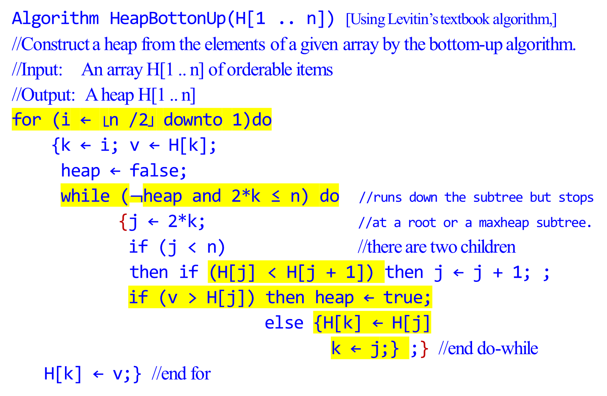
Algorithm HeapBottonUp(H[1 .. n]) [Using Levitin’s textbook algorithm,]
//Construct a heap from the elements of a given array by the bottom-up algorithm.
//Input: An array H[1 .. n] of orderable items
//Output: A heap H[1 .. n]
for (i ← └n /2┘ downto 1)do
{k ← i; v ← H[k];
heap ← false;
while ($¬$heap and 2*k ≤ n) do //runs down the subtree but stops
{j ← 2*k; //at a root or a maxheap subtree.
if (j < n) //there are two children
then if (H[j] < H[j + 1]) then j ← j + 1; ;
if (v > H[j]) then heap ← true;
else {H[k] ← H[j]
k ← j;} ;} //end do-while
H[k] ← v;} //end for

Slide 34
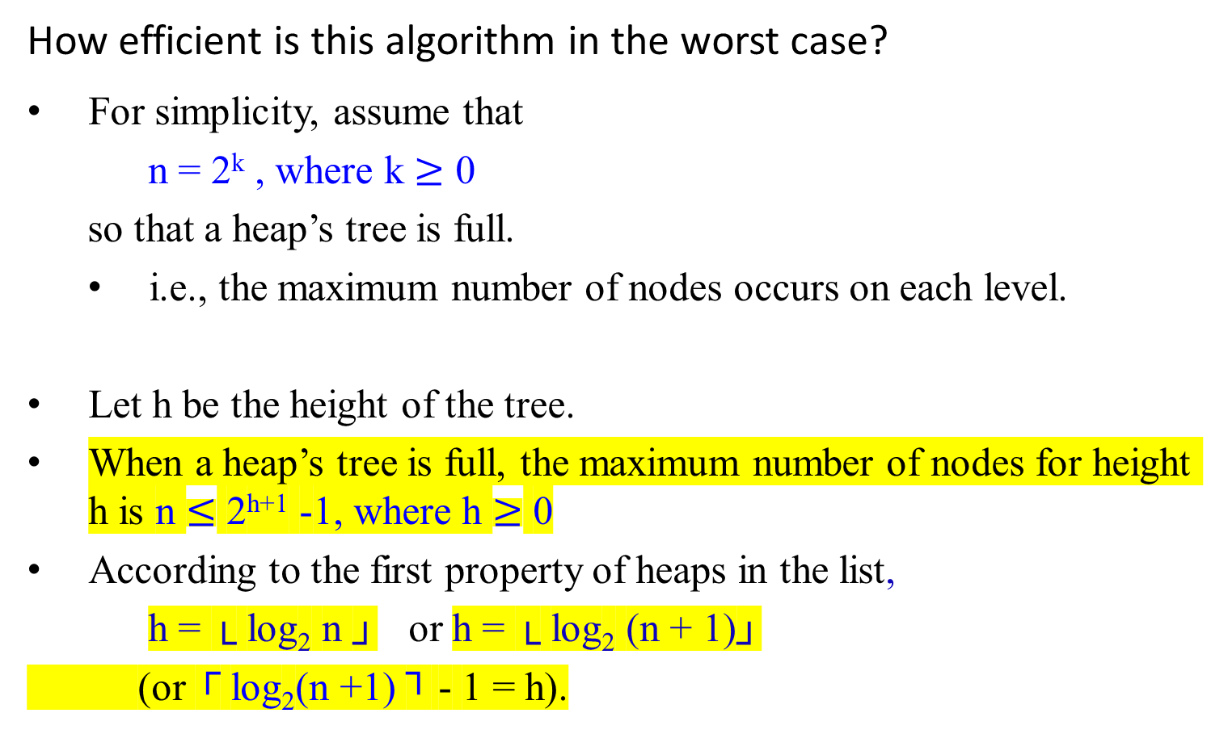
k = 0 (1 node)
k = 1 (2 nodes)
k = 2 (4 nodes)
k = 3 (8 nodes)
k = 4 (16 nodes)
How efficient is this algorithm in the worst case?
For simplicity, assume that
n = 2^{k} , where k $≥$ 0
so that a heap’s tree is full.
i.e., the maximum number of nodes occurs on each level.
Let h be the height of the tree.
When a heap’s tree is full, the maximum number of nodes for height h is n $≤$ 2^{h+1} -1, where h $≥$ 0
According to the first property of heaps in the list,
h = └ log₂ n ┘ or h = └ log₂ (n + 1)┘
(or ┌ log₂(n +1) ┐ - 1 = h).

Slide 35
In the worst case of the heap construction algorithm,
each key on level i of the tree will travel to the leaf level h.
Since moving to the next level down requires two comparisons:
one to find the largest child and
the other to determine whether the exchange is required.
the total number of key comparisons involving a key on level i with be 2(h - i).

Slide 36
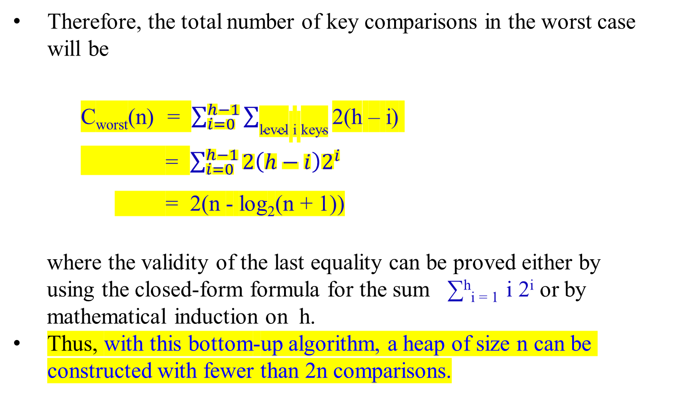
Therefore, the total number of key comparisons in the worst case will be
C_{worst}(n) = $\sum_{i=0}^{h−1}{\sum_{\text{level} \text{i} \text{keys}}{\text{2(}\text{h}\text{ – }\text{i}\text{) }}}$
= $\sum_{i=0}^{h−1}{{2\left(h−i\right)2}^{i}}$
= 2(n - log₂(n + 1))
where the validity of the last equality can be proved either by
using the closed-form formula for the sum ∑^{h}_{i = 1} i 2^{i} or by
mathematical induction on h.
Thus, with this bottom-up algorithm, a heap of size n can be constructed with fewer than 2n comparisons.

Slide 37
Figure 6-3 is an example of the action of HeapBottomUp(A[1..n]).
Figure 6.3 The operation of HeapBottomUp(A[1..n]), showing the data structure before the call to Max-heapify in line 3 of HeapBottomUp(A[1..n]).
A 10 element input array A and the binary tree it represents.
The figure shows that the loop index i refers to node 5 before
the call Max-Heapify(A, i).

Slide 38
A
4 | 1 | 3 | 2 | 16 | 9 | 10 | 14 | 8 | 7
4 | 1 | 3 | 2 | 16 | 9 | 10 | 14 | 8 | 7
1 4
(a)
2 1 3 3
4 2 5 16 6 9 7 10
8 14 9 8 10 7

Slide 39
A
4 | 1 | 3 | 2 | 16 | 9 | 10 | 14 | 8 | 7
1 4
(b)
2 1 3 3
4 2 5 16 6 9 7 10
8 14 9 8 10 7
(b) The data structure that results.
The loop index i for the next iteration refers to node 4.

Slide 40
(c) – (e ) Subsequent iterations of the for loop in HeapBottomUp(A[1..n]).
Observe that when Max-Heapify is called on a node, the two
subtrees of that node are both max-heaps.

Slide 41
4 | 1 | 3 | 2 | 16 | 9 | 10 | 14 | 8 | 7
A
4 | 1 | 3 | 14 | 16 | 9 | 10 | 2 | 8 | 7
4 | 1 | 3 | 14 | 16 | 9 | 10 | 2 | 8 | 7
1 4
(c)
2 1 3 3
4 14 5 16 6 9 7 10
8 2 9 8 10 7

Slide 42
4 | 1 | 3 | 14 | 16 | 9 | 10 | 2 | 8 | 7
A
4 | 1 | 10 | 14 | 16 | 9 | 3 | 2 | 8 | 7
4 | 1 | 10 | 14 | 16 | 9 | 3 | 2 | 8 | 7
1 4
(d)
2 1 3 10
4 14 5 16 6 9 7 3
8 2 9 8 10 7

Slide 43
A
4 | 1 | 10 | 14 | 16 | 9 | 3 | 2 | 8 | 7
4 | 16 | 10 | 14 | 1 | 9 | 3 | 2 | 8 | 7
4 | 16 | 10 | 14 | 1 | 9 | 3 | 2 | 8 | 7
1 4
(e)
2 16 3 10
4 14 5 7 6 9 7 3
4 | 16 | 10 | 14 | 7 | 9 | 3 | 2 | 8 | 1
8 2 9 8 10 1
4 | 16 | 10 | 14 | 7 | 9 | 3 | 2 | 8 | 1

Slide 44
4 | 16 | 10 | 14 | 7 | 9 | 3 | 2 | 8 | 1
A
16 | 4 | 10 | 14 | 7 | 9 | 3 | 2 | 8 | 1
16 | 4 | 10 | 14 | 7 | 9 | 3 | 2 | 8 | 1
16 | 14 | 10 | 4 | 7 | 9 | 3 | 2 | 8 | 1
1 16
(f) The max-heap after
HeapBottomUp(A[1..n])
finishes.
At A[5], it is a max subtree, stop going down to the bottom.
2 14 3 10
4 8 5 7 6 9 7 3
16 | 14 | 10 | 8 | 7 | 9 | 3 | 2 | 4 | 1
8 2 9 4 10 1
16 | 14 | 10 | 8 | 7 | 9 | 3 | 2 | 4 | 1

Slide 45
The top-down heap construction algorithm
Construct a heap by successive insertion of a new key K into a previously constructed heap.
First, attach a new node with key K in it after the last leaf of the existing heap.
Then sift K up to its appropriate place in the new heap as follows:
Compare K with its parent’s key:
if the latter is greater than or equal to K, stop (the structure is a heap);
otherwise,
swap these two keys and compare K with its new parent.
This swapping continues until K is not greater than its last parent or it reaches the root.
In this algorithm, we can sift up an empty node until it reaches its proper position, where it will get K’s value.

Slide 46
Figure 6.12: Inserting a key 10 into the heap constructed in Figure 6.11.
The new key is shifted up via a swap with its parent until
it is not larger than its parent (or is in the root).
9
9
6
8
6
10
2
5
7
10
2
5
7
8
2, 9, 7, 6, 5, 8, 10

Slide 47
Figure 6.12: Inserting a key 10 into the heap constructed in Figure 6.11.
The new key is shifted up via a swap with its parent until
it is not larger than its parent (or is in the root).
9
10
6
10
6
9
2
5
7
8
2
5
7
8
2, 9, 7, 6, 5, 8, 10

Slide 48
This insertion operation requires key comparisons no more than the heap’s height.
The time efficiency of insertion is in O(log n), since the height of a heap with n nodes is about log₂ n.

Slide 49
Delete an item from a heap
Consider only the important case of deleting the root’s key,
leaving the question about deleting an arbitrary key in a heap for an exercise.

Slide 50
Maximum Key Deletion from a Heap
Step 1: Exchange the root’s key with the last key K of the heap.
Step 2: Decrease the heap’s size by 1.
Step 3: “Max-Heapify” the smaller tree by sifting K down the
tree exactly in the same way as it is done in the bottom-
up heap construction algorithm.
i.e., verify the parental dominance for K:
if it holds, we are done;
if not, swap K with the larger of its children and repeat this operation until the parental dominance condition holds for K in its new position.

Slide 51
The efficiency of deletion from a heap
The efficiency of deletion is determined by
the number of key comparisons needed to heapify the tree after the swap has been made and
the size of the tree is decreased by 1.
the time efficiency of deletion is in O(log n) as well,
since it requires key comparisons no more than twice the heap’s height,

Slide 52
Heapsort
Heapsort [discovered by J. W. J. Williams]
A two-stage algorithm:
Stage 1 (heap construction):
Construct a heap for a given array (Apply Max-Heapify)
Stage 2 (maximum deletions):
Apply the root-deletion operation n-1 times to the remaining heap.
As a result, the array elements are eliminated in decreasing order.
Under the array implementation of heaps,
an element being deleted is placed last in the remaining heap;
the resulting array will be exactly the original array sorted in ascending order.

Slide 53
Heapsort
Heapsort(A)
HeapBottomUp(A[1..n]); //Build-Max-Heap(A) (1st Max-Heapify)
for (i ← length[A] downto 2) do
{ exchange(A[1], A[i]); //place the root-deleted
//one to the last in the remaining heap
heap-size[A] ← heapsize[A] – 1;
Max-Heapify(A, 1);} //end for (2nd Max-Heapify)
The procedure Heapsort(A) takes time O(nlog n), since
the call to HeapBottomUp(A[1..n]) takes time O(n) and
each of the n-1 calls to Max-Heapify takes time O(log n).

Slide 54
Algorithm HeapBottomUp(A[1 .. n])
heap-size[A] ← length[A];
for (i ← └length[A]/2┘ downto 1) do {
Max-Heapify(A, i);}
(1st Max-Heapify)
the call to HeapBottomUp(A[1..n]) takes time O(n)
each of the n-1 calls to Max-Heapify takes time O(log n).

Slide 55

Max-Heapify(A, i) - Max-Heapify takes time O(log n).
// the root node of the left/right tree of the node i
left ← LEFT(i);
right ← RIGHT(i);
//the root node(index) is within size-bound,
//if the value of the root node, A[i], A[left] > A[i]
if (left ≤ heap-size[A] and A[left] > A[i])
then largest ← left
else largest ← i;
//if A[right] > max{A[left], A[i]}
if (right ≤ heap-size[A] and A[right] > A[largest])
then largest ← right;
if (largest ≠ i)
then {exchange(A[i], A[largest]);
Max-Heapify(A, largest)};
A[i]
A[left] A[right]
Find out which of the A[i] and A[left] is larger? Then name the larger one as A[largest], where the largest has the value of i or left.
Then, determine which of the A[right] and A[largest] is larger? If A[right] is larger than A[largest] then the largest has the value of right.
Finally, if the largest is not i, then swap A[i] and A[largest] where the largest can be left or right.
Then call Max-Heapify(A, largest) to ensure that the A[largest] is a max heap.

Slide 56
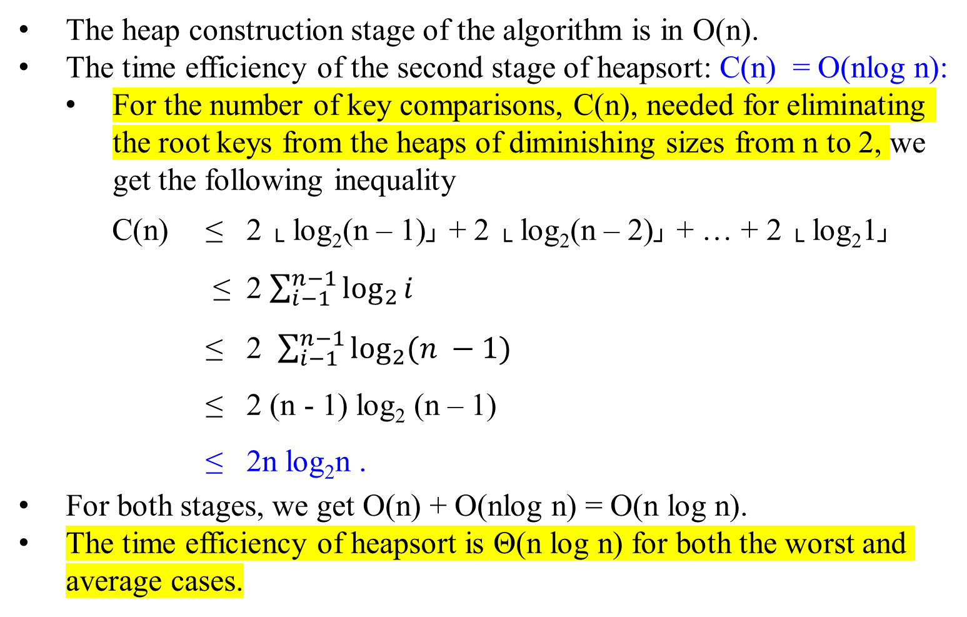
Heapsort
The heap construction stage of the algorithm is in O(n).
The time efficiency of the second stage of heapsort: C(n) = O(nlog n):
For the number of key comparisons, C(n), needed for eliminating the root keys from the heaps of diminishing sizes from n to 2, we get the following inequality
C(n) ≤ 2 └ log₂(n – 1)┘ + 2 └ log₂(n – 2)┘ + … + 2 └ log₂1┘
≤ 2 $\sum_{i−1}^{n−1}{\log_{2}{i}}$
≤ 2 $\sum_{i−1}^{n−1}{\log_{2}{(n −1)}}$
≤ 2 (n - 1) log₂ (n – 1)
≤ 2n log₂n .
For both stages, we get O(n) + O(nlog n) = O(n log n).
The time efficiency of heapsort is Θ(n log n) for both the worst and average cases.

Slide 57
Figure 6.4 The operation of Heapsort.
The max-heap data structure just
after “HeapBottomUp(A[1..n]);” has built it.
Heapsort
16
14
10
8
7
9
3
2
4
1
16 | 14 | 10 | 8 | 7 | 9 | 3 | 2 | 4 | 1

Slide 58
Heapsort
(b – j) The max-heap just after each call of Max-Heapify in the algorithm Heapsort(A), showing the value of i at that time. Only lightly shaded nodes remain in the heap.

Slide 59
Heapsort
Figure 6.4 The operation of Heapsort.
(b)
16 | 14 | 10 | 8 | 7 | 9 | 3 | 2 | 4 | 1
14
8
10
4
7
9
3
16 | 14 | 10 | 8 | 7 | 9 | 3 | 2 | 4 | 1
2
1
16
i
14 | 8 | 10 | 4 | 7 | 9 | 3 | 2 | 1 | 16
Max-Heapify(A, 1)

Slide 60
14 | 8 | 10 | 4 | 7 | 9 | 3 | 2 | 1 | 16
Max-Heapify(A, 1)
10 | 8 | 9 | 4 | 7 | 1 | 3 | 2 | 14 | 16
8
10
4
7
9
3
2
1
14
16

Slide 61
Heapsort
Figure 6.4 The operation of Heapsort.
(c)
10
8
9
4
7
1
3
2
14
16
10 | 8 | 9 | 4 | 7 | 1 | 3 | 2 | 14 | 16
i

Slide 62
Heapsort
Figure 6.4 The operation of Heapsort.
(d)
9
8
3
4
7
1
2
10
14
16
i

Slide 63
Heapsort
Figure 6.4 The operation of Heapsort.
(e)
8
7
3
4
2
1
9
10
14
16
i

Slide 64
Heapsort
Figure 6.4 The operation of Heapsort.
(f)
7
4
3
1
2
8
9
10
14
16
i

Slide 65
Heapsort
Figure 6.4 The operation of Heapsort.
(g)
4
2
3
1
7
8
9
10
14
16
i

Slide 66
Heapsort
Figure 6.4 The operation of Heapsort.
(h)
3
2
1
4
7
8
9
10
14
16
i

Slide 67
Heapsort
Figure 6.4 The operation of Heapsort.
(i)
2
1
3
4
7
8
9
10
14
16
i

Slide 68
Heapsort
Figure 6.4 The operation of Heapsort.
(j)
1
2
3
4
7
8
9
10
14
16
i

Slide 69
Heapsort
(k) The resulting sorted array A.
1 | 2 | 3 | 4 | 7 | 8 | 9 | 10 | 14 | 16
Time efficiency:
The worst case running time of Heapsort is Ω(n log n).
When all elements are distinct, the best-case running time of Heapsort is Ω(n log n).

Slide 70
Algorithm | Worst-case running time | Average-case/expected running time
Insertion sort | Ɵ(n²) | Ɵ(n²)
Merge sort | Ɵ(n log n) | Ɵ(n log n)
Heapsort | O(n log n) | -
Quicksort | Ɵ(n²) | Ɵ(n log n) (expected)
Counting sort | Ɵ(k + n) | Ɵ(k + n)
Radix sort | Ɵ(d(n +k)) | Ɵ(d(n +k))
Bucket sort | Ɵ(n²) | Ɵ(n) (Average-case)

Slide 71
Transformation and Conquer
Problem Reduction

Slide 72
The End

